Slide 1
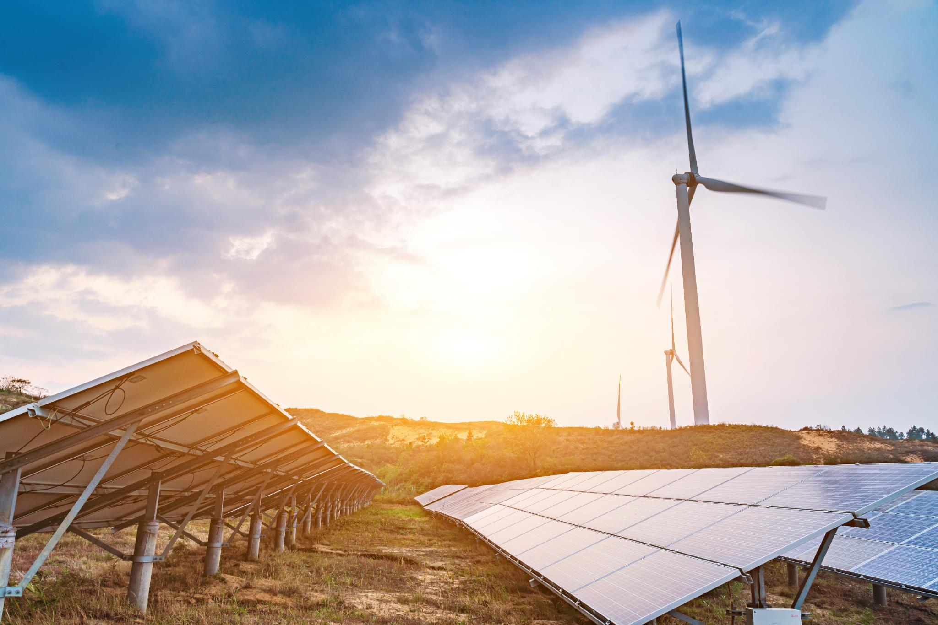
Quezon Renewable Energy Hub Investor Presentation
Opportunity for sustainable energy investment in Quezon
Group 12: CEO, Redouane Afilali 2403366
VP, Chippy Chandra Pillai 2403836
Operation director Vishvkumar Patel 2403261
Notes:
---

Slide 2
Project Overview
Notes:
Project Scope and Objectives

Slide 3
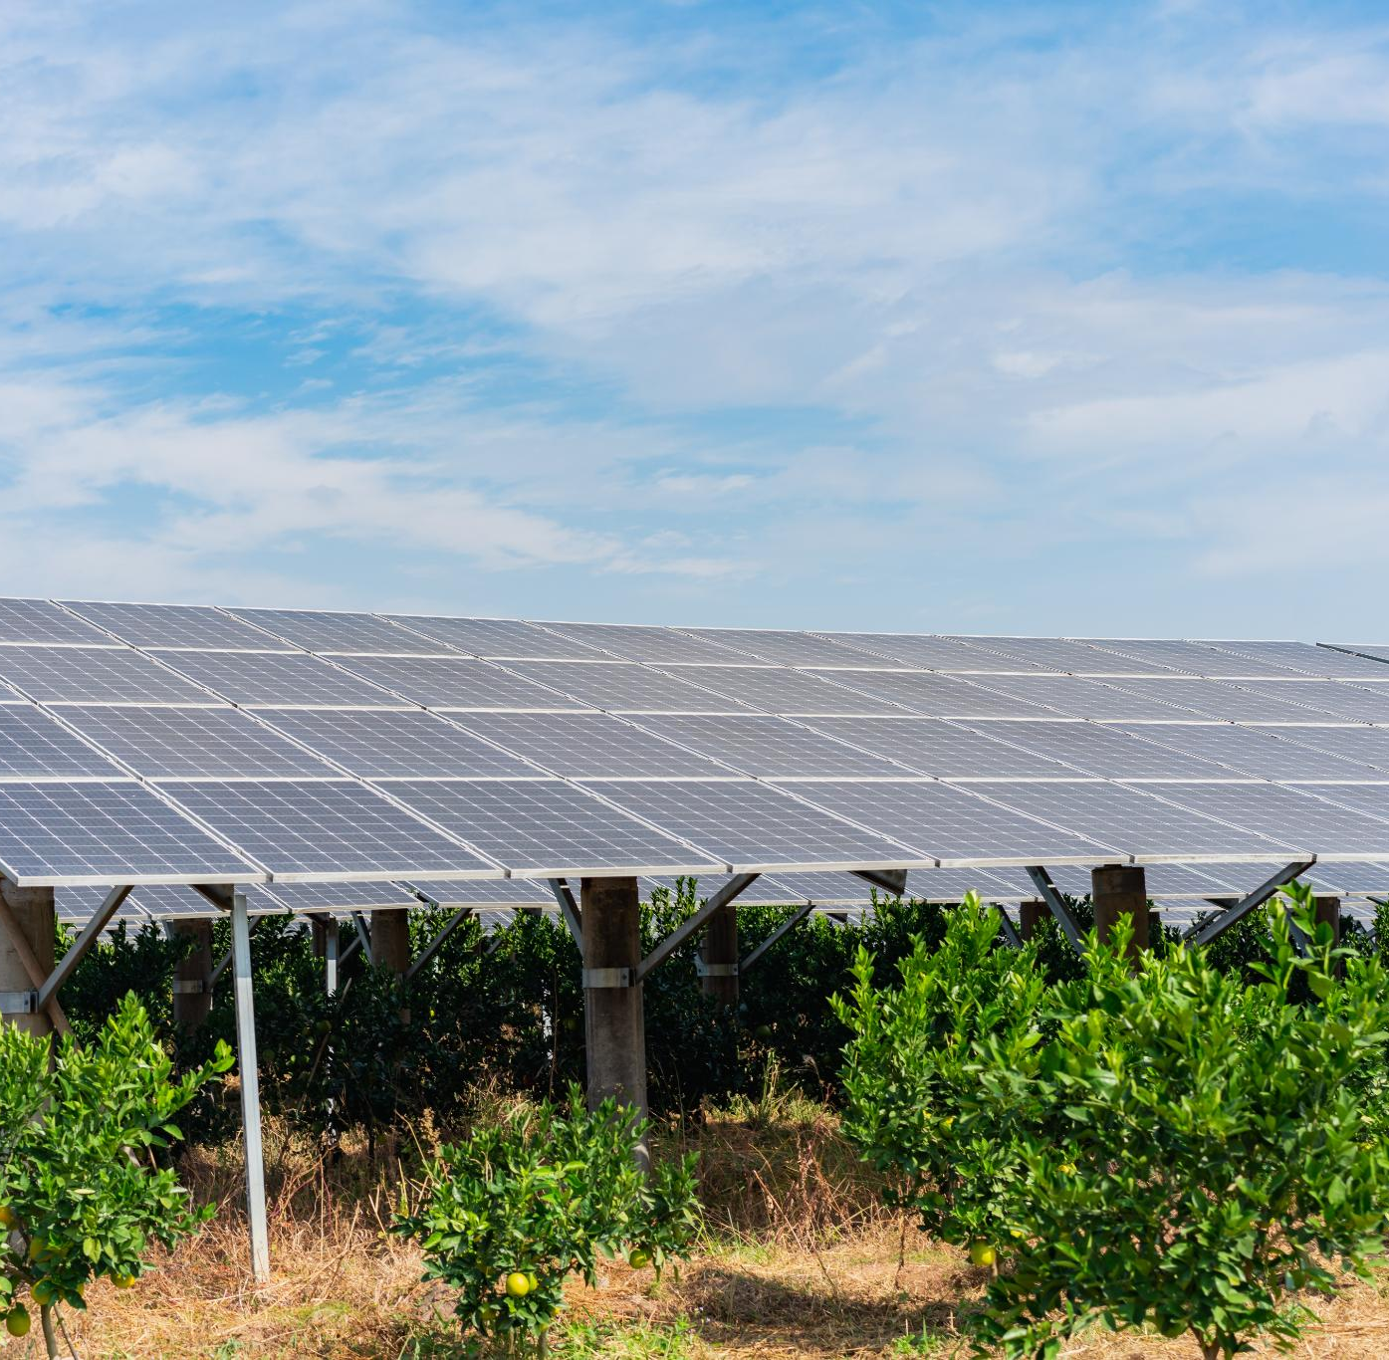
Project Scope and Objectives
Integrated Renewable Systems
  The project combines solar photovoltaic(150 MW), wind turbines(80 MW), and energy storage(20MW) to supply clean power to the Luzon grid.
Goals and Objectives
  Aims to accelerate renewable energy adoption, reduce emissions, and improve energy security in Southeast Asia.
Investment and Impact
  With $280 million invested, the hub targets sustainable returns and supports the Philippines' climate and energy strategies.
Notes:
The Quezon Renewable Energy Hub is a transformative infrastructure project located in Quezon Province, Philippines. It integrates solar photovoltaic systems, wind turbines, and battery energy storage to deliver clean, reliable power to the national grid. The project's primary objective is to accelerate the transition to renewable energy in Southeast Asia, reduce carbon emissions, and enhance energy security. With a total investment of $180 million, the project aims to generate sustainable returns while contributing to the Philippines' climate goals and energy diversification strategy.

Slide 4
Market Opportunity
Notes:
Renewable Energy Demand and Incentives

Slide 5
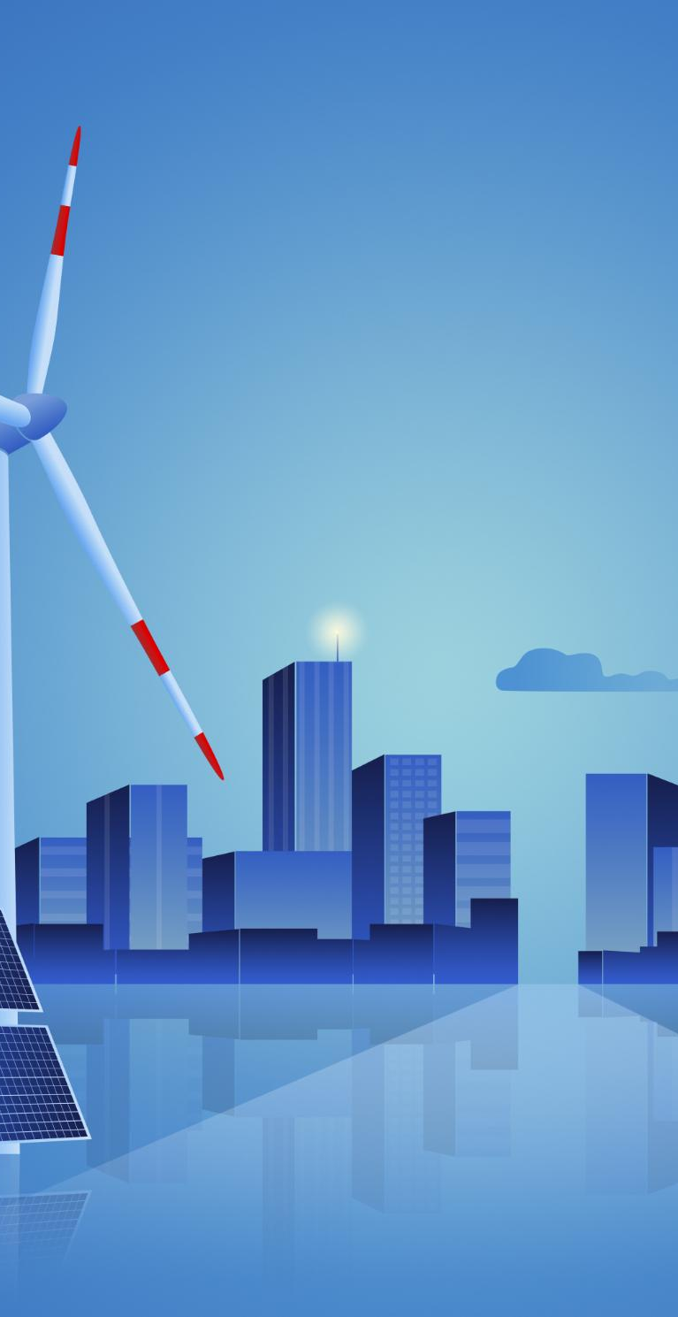
Renewable Energy Demand and Incentives
Rising Renewable Energy Demand
  Population growth and urbanization in Southeast Asia drive increasing demand for renewable energy solutions.
Government Incentives in Philippines
  The Philippines offers tax holidays, feed-in tariffs, and carbon credit eligibility to promote clean energy projects.
Renewable Potential in Quezon Province
  High solar irradiance(~4.8 kWh/m²/day) and coastal winds(avg 6.2m/s) make Quezon Province ideal for renewable energy development.
Alignment with Sustainability Policies
  Projects align with national energy policies and international sustainability frameworks for long-term growth.
Notes:
Southeast Asia is experiencing a surge in demand for renewable energy, driven by population growth, urbanization, and climate commitments. The Philippines offers attractive incentives for clean energy projects, including tax holidays, feed-in tariffs, and carbon credit eligibility. Quezon Province, with its high solar irradiance and coastal wind potential, is strategically positioned to capitalize on these trends. The project aligns with national energy policies and international sustainability frameworks, making it a compelling opportunity for investors seeking long-term growth in the green energy sector.

Slide 6
Financial Highlights
Notes:
Key Financial Metrics

Slide 7

Key Financial Metrics
Investment Returns
  The project shows a strong Internal Rate of Return of 12% and a Net Present Value of $45 million.
Project Profitability
Equity IRR of 12.5% indicating solid profitability for investors.
Financial Resilience
Debt coverage ratios such as ADSCR averaging 1.45x and LLCR of 1.6x reflect financial stability.
Value Creation
  Project Payback Period of 9-11 years shows reasonable return timeline for infrastructure investment.
Notes:
The Quezon Renewable Energy Hub demonstrates robust financial performance. Key metrics include an Internal Rate of Return (IRR) of 15%, Net Present Value (NPV) of $140.24 million, and a Return on Project (ROP) of 316.67%. The Return on Quality (RoQ) stands at 45.98%, indicating strong value creation relative to lifecycle costs. Debt service coverage is solid, with an Average ADSCR of 1.95 and Average LLCR of 1.73. These figures reflect the project's profitability, resilience, and attractiveness to both equity and debt investors.

Slide 8
Risk Mitigation Strategies
Notes:
Comprehensive Risk Management

Slide 9

Comprehensive Risk Management
Financial Risk Mitigation
  Cost overruns are managed with 15% contingency reserves and fixed-price contracts to control project expenses effectively.
Financing and Currency Risks
  Financing risks are reduced using green bonds and early lender commitments; currency exposure is managed by hedging and local currency debt.
Regulatory and Operational Risk
  Active policy engagement addresses regulatory risks, while operational risks are minimized through proven technology and O&M contracts.
ESG Risk Management
  ESG risks are mitigated by transparent reporting and engaging local communities to ensure sustainable project development.
Notes:
The project incorporates robust risk mitigation strategies across financial, operational, and regulatory domains. Cost overruns are addressed through contingency reserves and fixed-price EPC contracts. Financing risks are mitigated via green bonds and early lender commitments. Currency exposure is managed through hedging and local currency debt. Revenue risks are minimized by securing long-term Power Purchase Agreements (PPAs). Regulatory risks are addressed through active policy engagement, while operational risks are reduced by using proven technologies and O&M contracts. ESG risks are managed through transparent reporting and community engagement.

Slide 10
ESG Commitments
Notes:
Environmental, Social, and Governance Goals

Slide 11
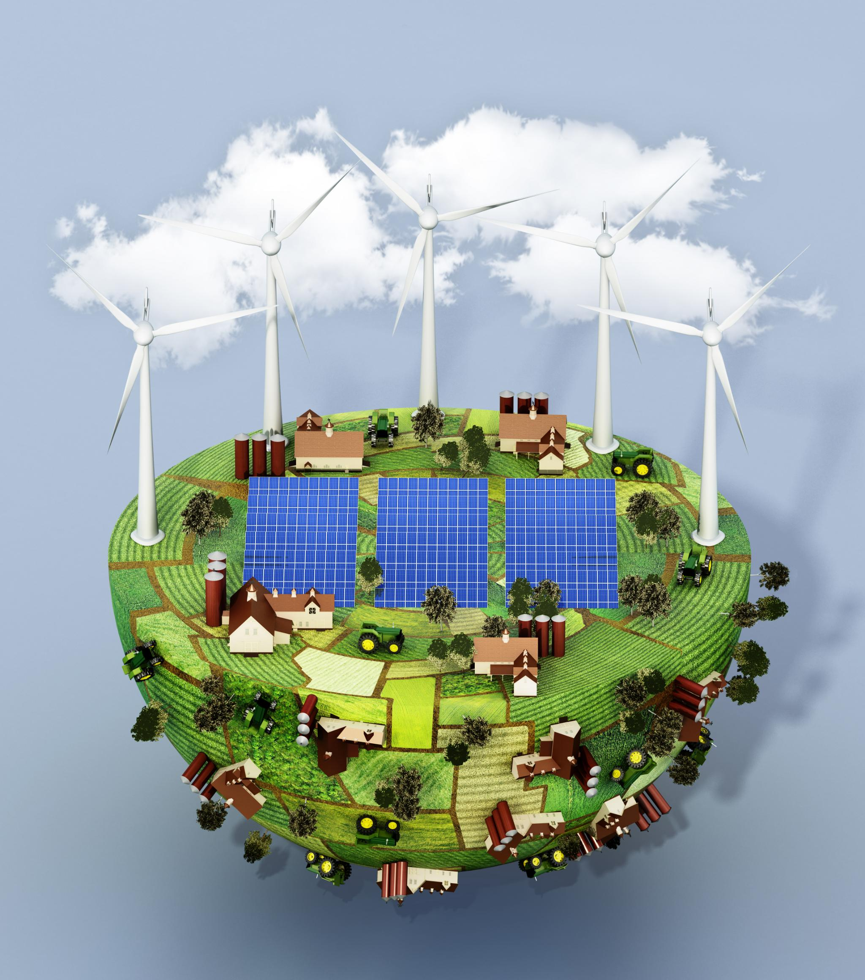
Environmental, Social, and Governance Goals
Environmental Initiatives
  Focused on land restoration, biodiversity protection, and carbon offset programs to reduce environmental impact.
Social Commitments
  Promotes workforce training, local employment, and community benefit programs to support social development.
Governance Practices
  Implements annual ESG reporting, stakeholder transparency, and ethical business conduct to ensure accountability.
Notes:
The Quezon Renewable Energy Hub is committed to high standards of Environmental, Social, and Governance (ESG) performance. Environmental initiatives include land restoration, biodiversity protection, and carbon offset programs. Social commitments involve workforce training, local employment, and community benefit programs. Governance practices include annual ESG reporting aligned with TCFD and GRI standards, stakeholder transparency, and ethical business conduct. These ESG measures enhance the project's sustainability profile and appeal to impact-focused investors.

Slide 12
Scenario Analysis
Notes:
---
This slide references information from the following file: https://henryadavis.com/wp-content/uploads/2015/12/PROJECT-FINANCE-PRACTICAL-CASE-STUDIES-VOLUME-I-POWER-AND-WATER.pdf,https://studylib.net/doc/9879024/quezon-coal-plant-case-study,https://www.linkedin.com/pulse/global-success-stories-case-studies-successful-project-asim-javed-b84sf
Financial Resilience Across Risk Scenarios

Slide 13
Financial Resilience Across Risk Scenarios
Scenario | NPV (USD) | Average ADSCR | Average LLCR
Base Case | $42.50 M | 1.50 | 1.55
Moderate Risk | $18.56M | 1.38 | 1.42
High Risk | $5.2M | 1.28 | 1.31
Notes:
---
This slide references information from the following file: https://henryadavis.com/wp-content/uploads/2015/12/PROJECT-FINANCE-PRACTICAL-CASE-STUDIES-VOLUME-I-POWER-AND-WATER.pdf,https://studylib.net/doc/9879024/quezon-coal-plant-case-study,https://www.linkedin.com/pulse/global-success-stories-case-studies-successful-project-asim-javed-b84sf
The project was evaluated under three scenarios: Base Case, Moderate Risk, and High Risk. In the Base Case, NPV is $140M, ADSCR is 1.95, and LLCR is 1.73. Under Moderate Risk (10% cost overrun, 5% revenue drop), NPV is $103M, ADSCR is 1.83, and LLCR is 1.63. In the High Risk scenario (20% cost overrun, 10% revenue drop, +1% interest), NPV remains positive at $67M, with ADSCR at 1.61 and LLCR at 1.53. These results demonstrate the project's financial resilience and ability to maintain lender thresholds even under adverse conditions.

Slide 14
Call to Action
Notes:
Investor Engagement

Slide 15
Investor Engagement
Invitation to Invest
We invite investors to join in advancing sustainable energy for a cleaner future with high-impact projects.
Project Opportunity
The Quezon Renewable Energy Hub offers a high-return project aligned with global climate goals.
Contact Information
For inquiries and partnerships, contact via email or visit the project website for more details.
Notes:
We invite investors to join us in powering the future through sustainable energy. The Quezon Renewable Energy Hub offers a compelling opportunity to participate in a high-impact, high-return project that aligns with global climate goals. For inquiries and partnership discussions, please contact ceo@quezonenergyhub.com or visit www.quezonenergyhub.com.

Slide 16
llm experience
Notes:
Investor Engagement

Slide 17

LLM experience generating Finance plan for this project
* Feeding prompts, searching and drafting
* Provides structured analysis from multiple sources aligned with the course textbook material..
Verification Process
* Cross-check with official data and references
* Ensure technical specs match book material
Avoiding Hallucinations
* Apply consistency checks with uploaded files
* Manual review before finalization

